Slide 1
MATRIX BOT
Developed by SENTINELS

Slide 2
Introduction
This program will provide a learner to learn about various types of matrix, also their definitions and examples and will be explained them to the learner. It will help a learner to identify various types of matrix. A learner will be able to solve mathematical problems related to matrix by using this program. At last a learner will be able to see the history of calculations done by the learner earlier.

Slide 3
Features
Definitions of Matrices.
Identification of Matrices.
Calculation of Matrices.
History of Calculations.

Slide 4
Implementation

Slide 5
Welcome screen
Adjoint, Inverse, Identity, Null, Idempotent, Nilpotent, Involutory, Transpose, Sub-matrix, Skew-symmetric…
Identity, Triangular, Idempotent, Singular, Involutory, Transpose, Scaler matrix, Skew-symmetric
Definition
Main
menu
Identification
Calculation
Addition, Subtraction, Multiplication, Division, Row/Column sum, Determinant, Adjoint, Inverse, Transpose, Trace
History
Exit screen

Slide 6


Slide 7
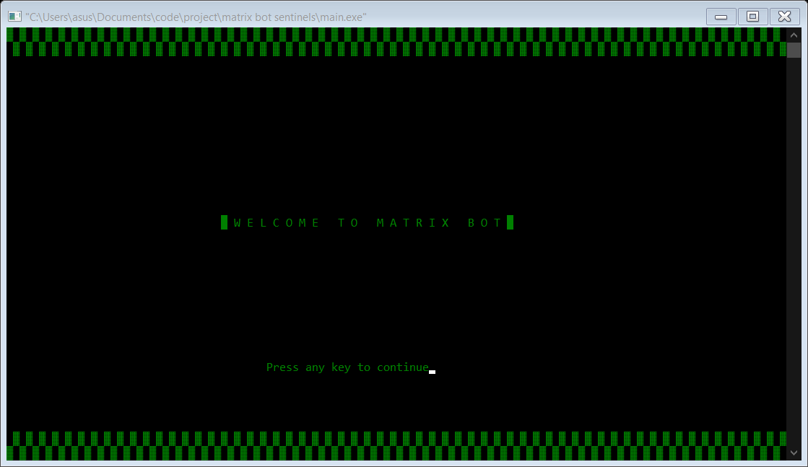
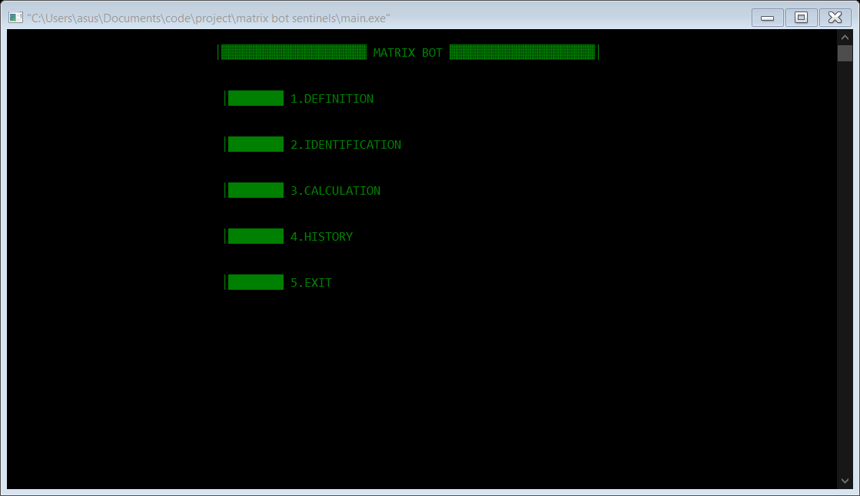

Slide 8
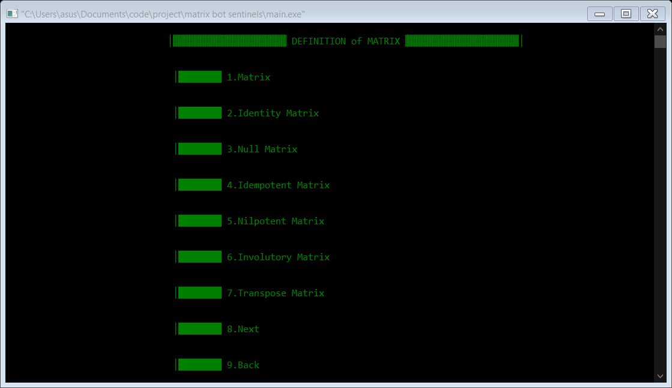
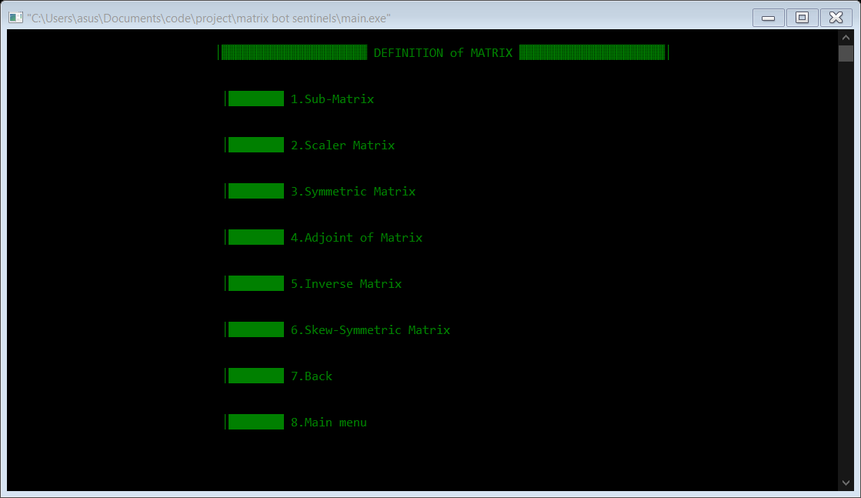

Slide 9
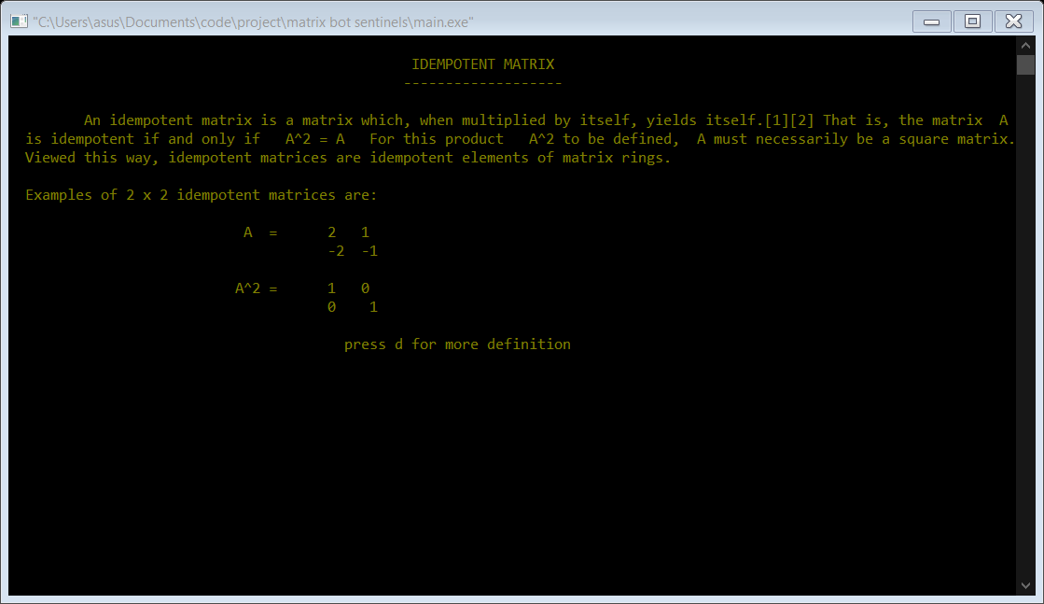
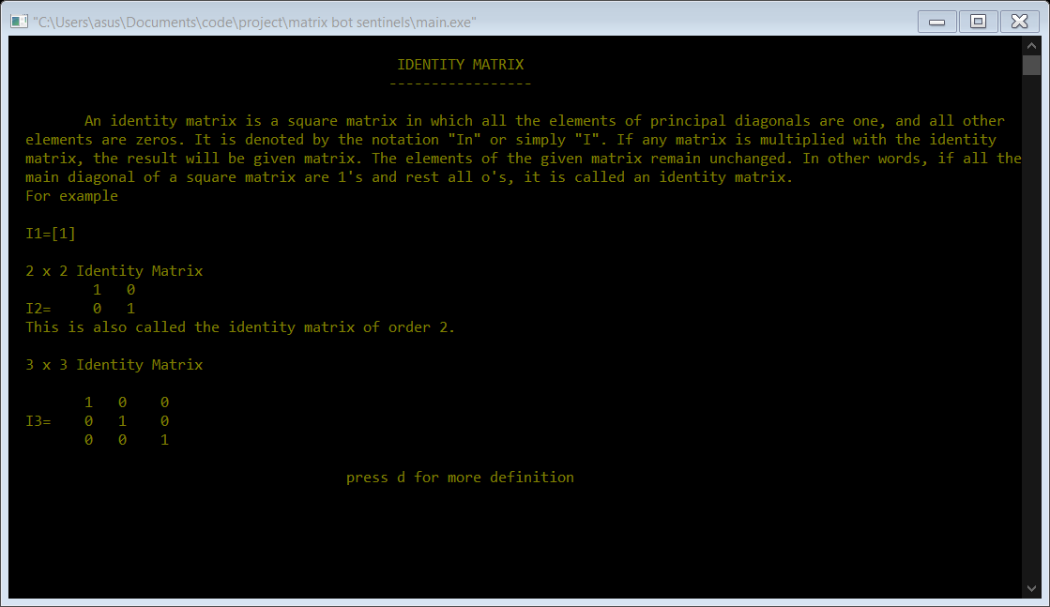
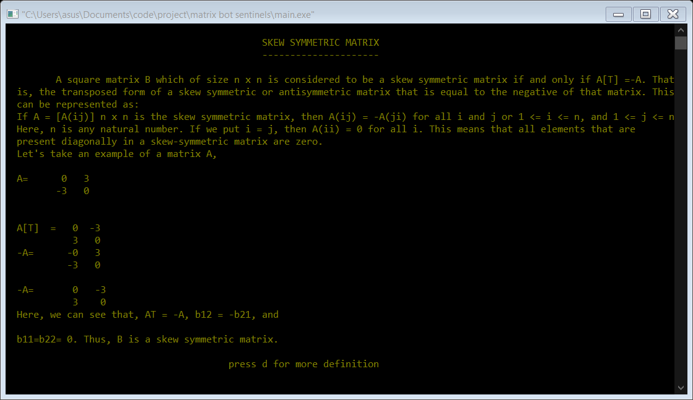

Slide 10
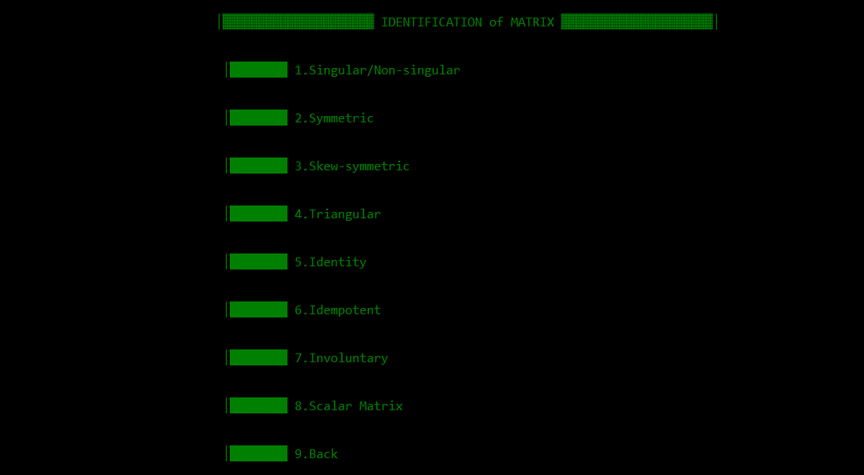

Slide 11
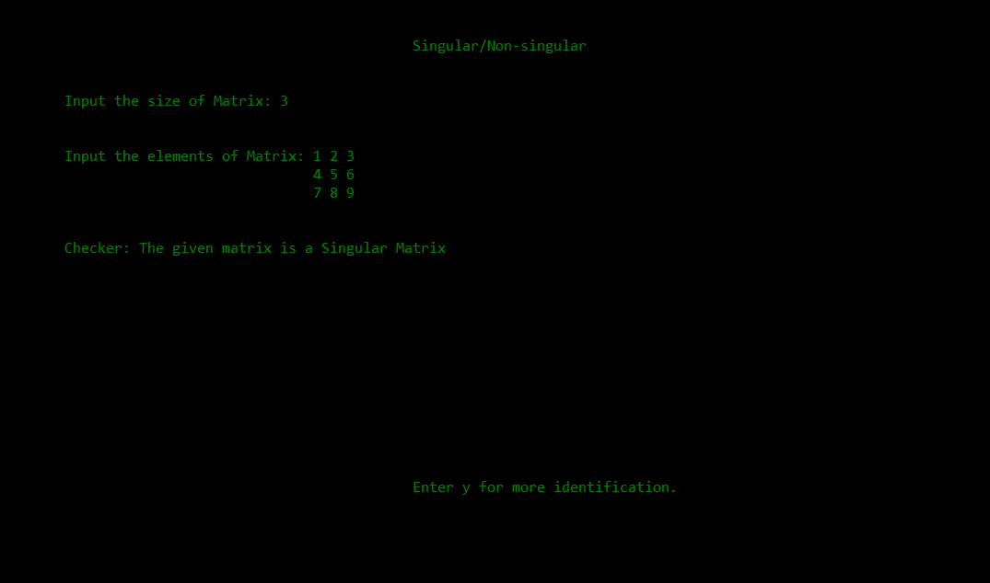
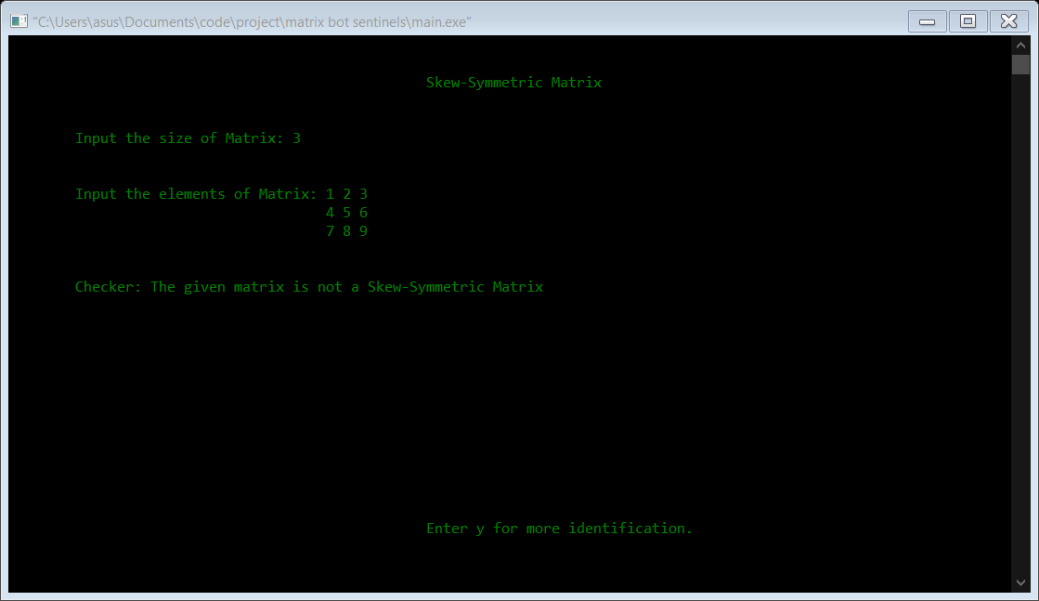
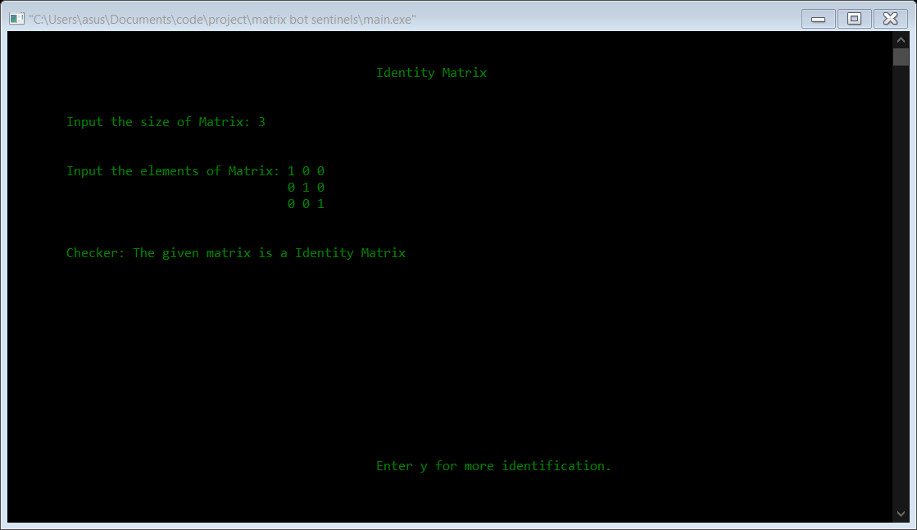

Slide 12
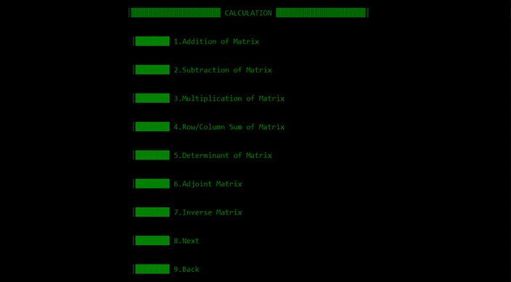
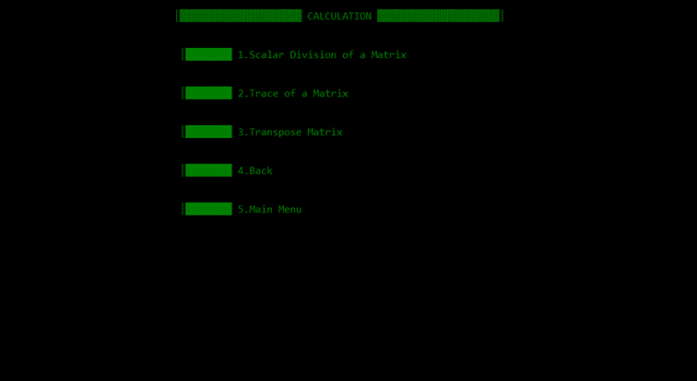

Slide 13
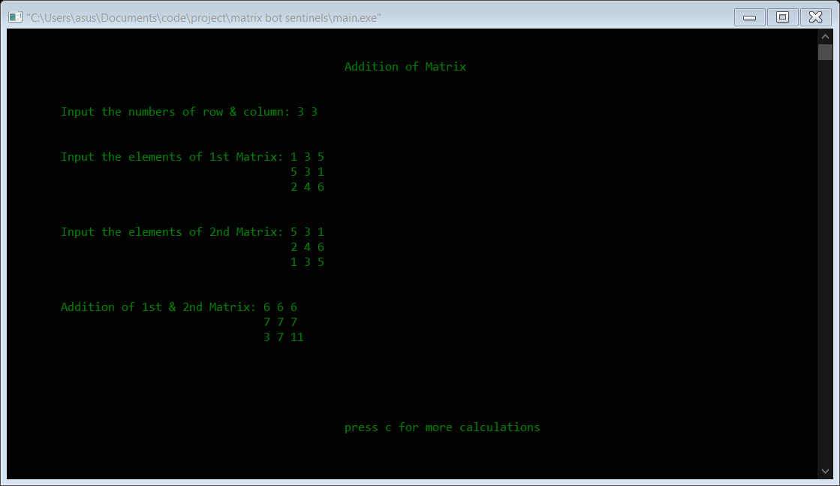
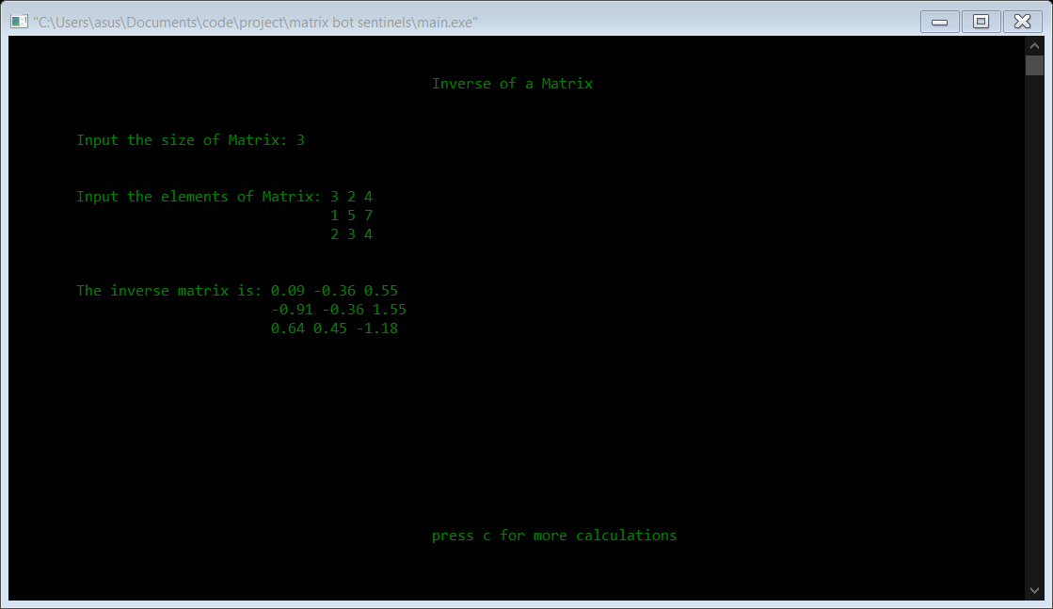
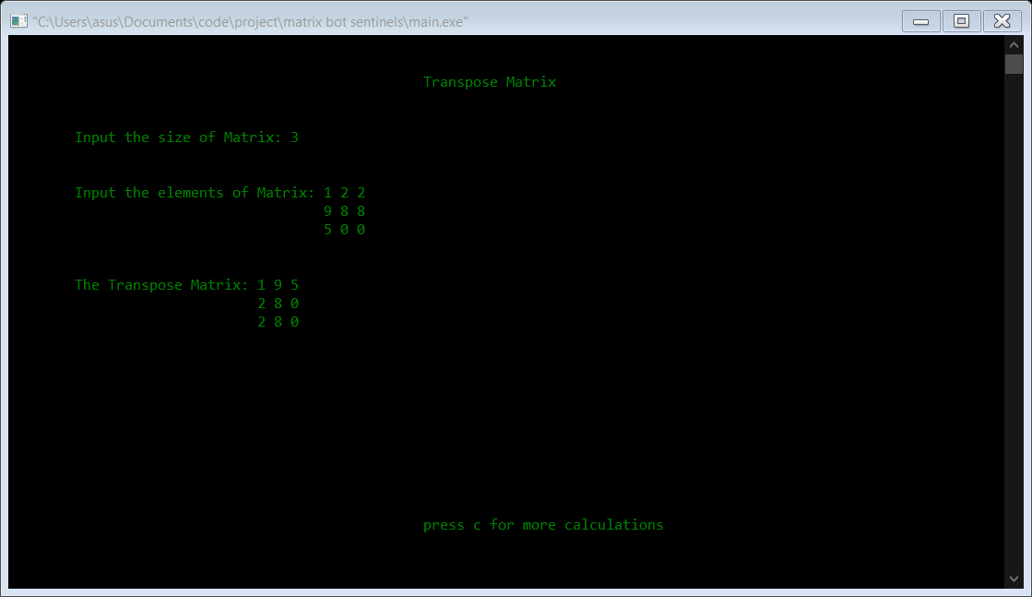

Slide 14
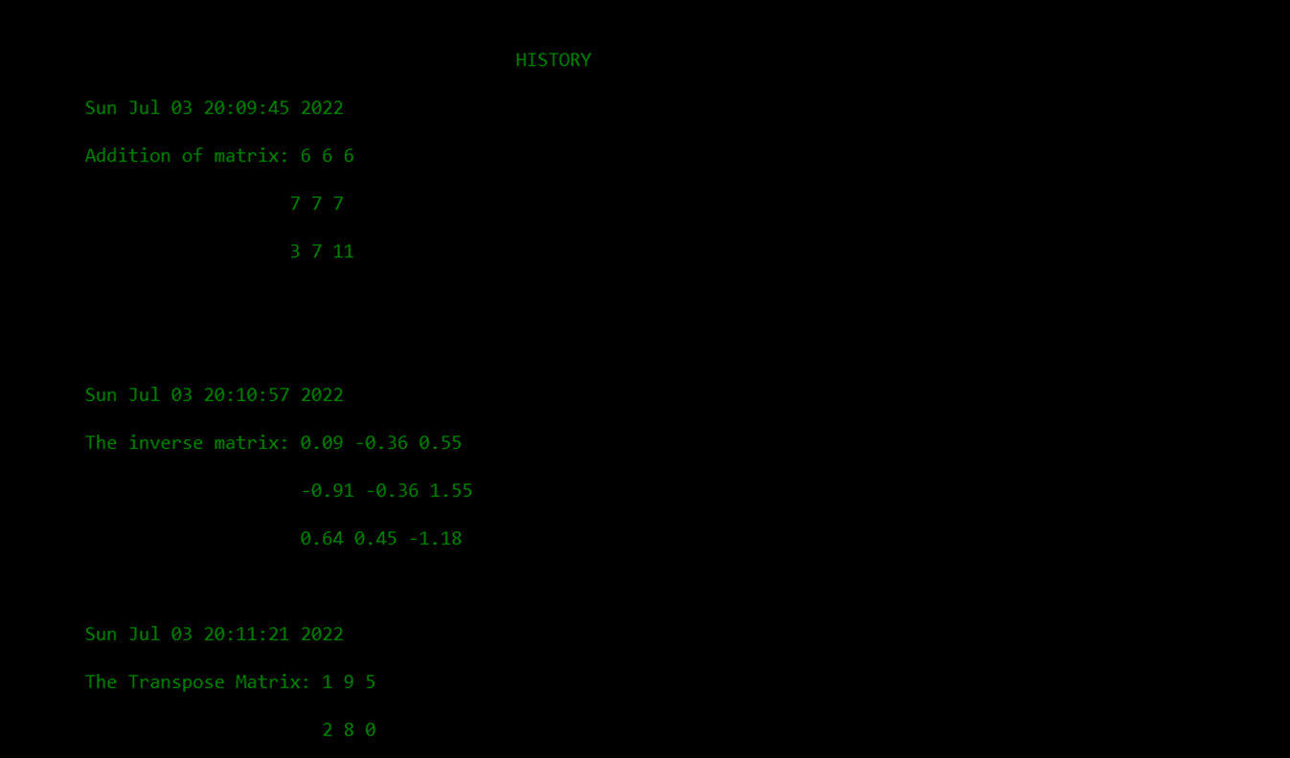
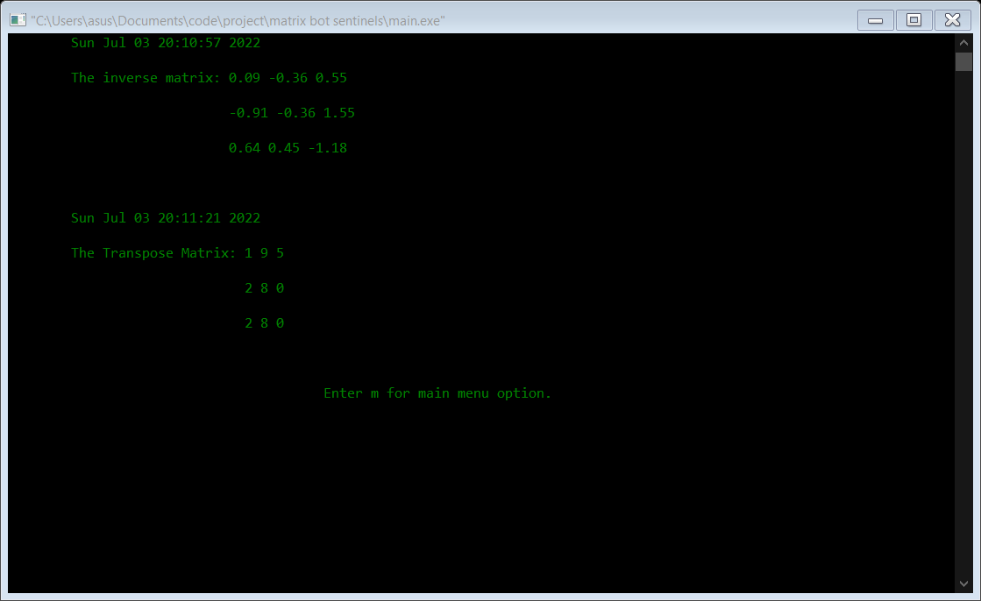

Slide 15


Slide 16
Possible Extensions:
Answers from history will be added automatically in calculations.
A matrix will be identified by each definitions instead of a specific one.
A segment will be added for users to practice mathematical problem related to matrix.

Slide 17
THANK YOU

